Slide 1
Muhammad Waseem, PhD (Thesis Submitted )
Senior AI & Generative Researcher | Cybersecurity Specialist |Lecturer|Trainer
🔹 Research Focus
Generative AI (Text-to-Video, Diffusion Models, LLM Integration)
Multimodal AI (Text + Image + Audio + Video)
Healthcare AI (Alzheimer’s, Epilepsy, TB Detection, Nursing Assist Tools, Covid Analyzer Assistant)
AI for Social Good (Fire detection, Urdu AI systems, Assistive Tech)
🔹 Key Achievements
15+ AI Projects: Urdu text-to-image, Alzheimer’s dual-module assistant (98% accuracy)
Publications in IEEE & Elsevier: LCGD (Text-to-Video), IMETA-GNN, Healthcare AI
Hands-on with LLMs: RAG, Agentic RAG, Multimodal pipelines
15+ years Teaching & Research Supervision
🔹 Technical Skills
Languages/Frameworks: Python, PyTorch, TensorFlow, OpenCV, Django, Flask
Specialization: LLMs, Generative AI, MLOps, Diffusion Models, Computer Vision, NLP
Domains: Healthcare, Sustainability, Criminology, Education
📫 Contact: m.wasi17@gmail.com | LinkedIn: muhammadwaseem00 | GitHub: muhammadwaseem00

Slide 2
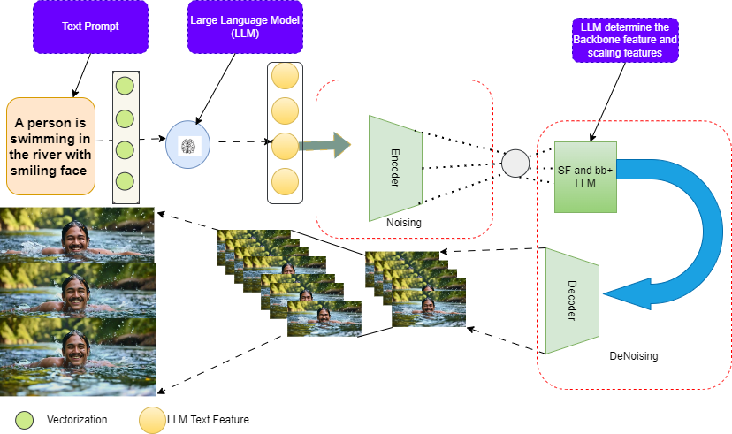
LCGD:Text-to-VideoGeneration via Contextual LLMGuidance and U-Net Denoising

Slide 3
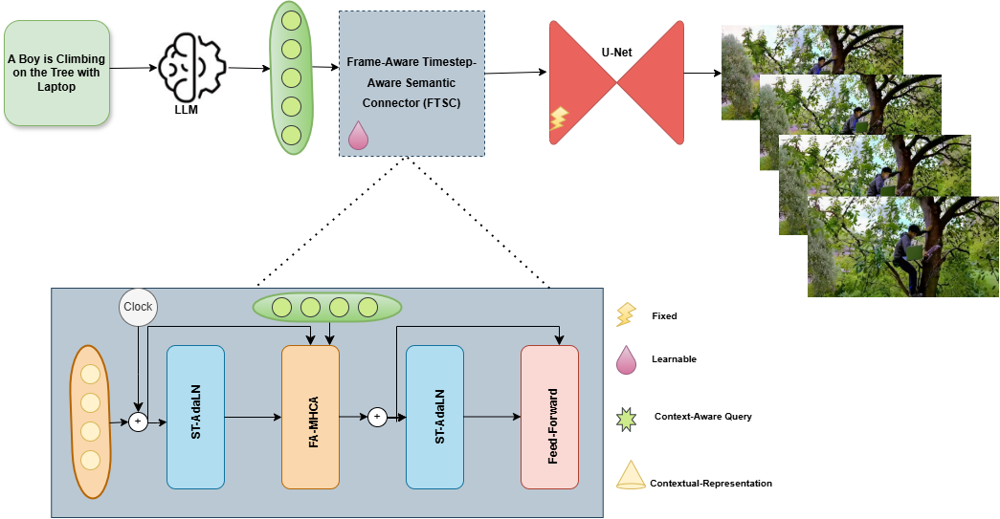
FTSC:A Semantic–Temporal DiffusionFramework for Coherent Text-to-VideoSynthesis

Slide 4
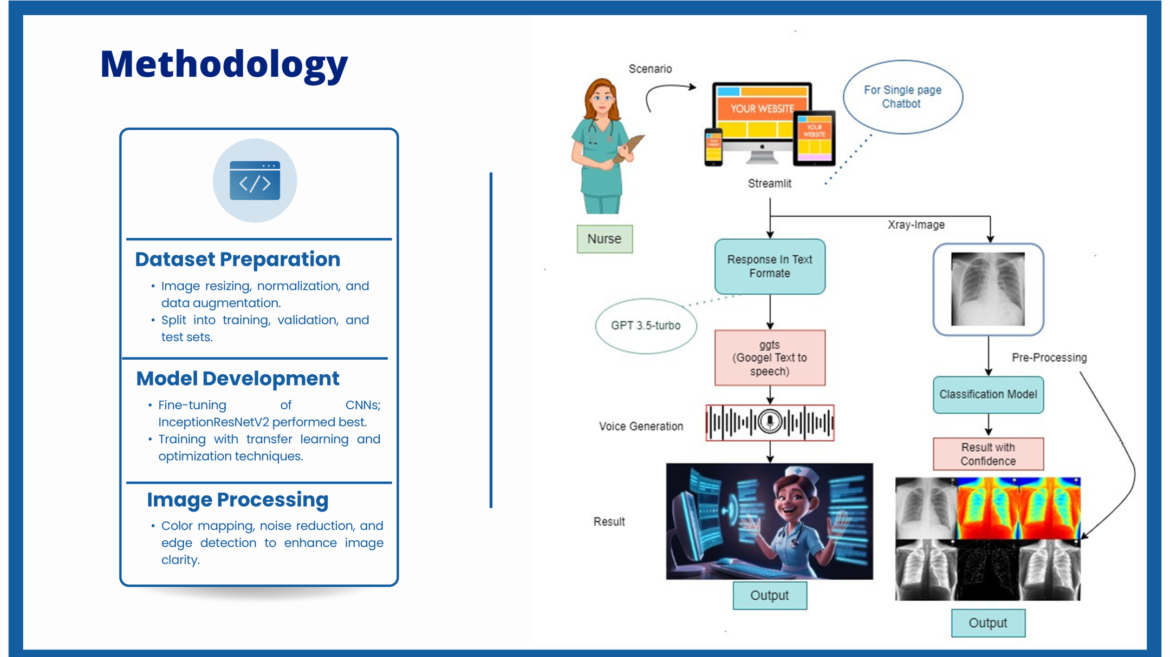
Covid Analyzer

